Slide 1
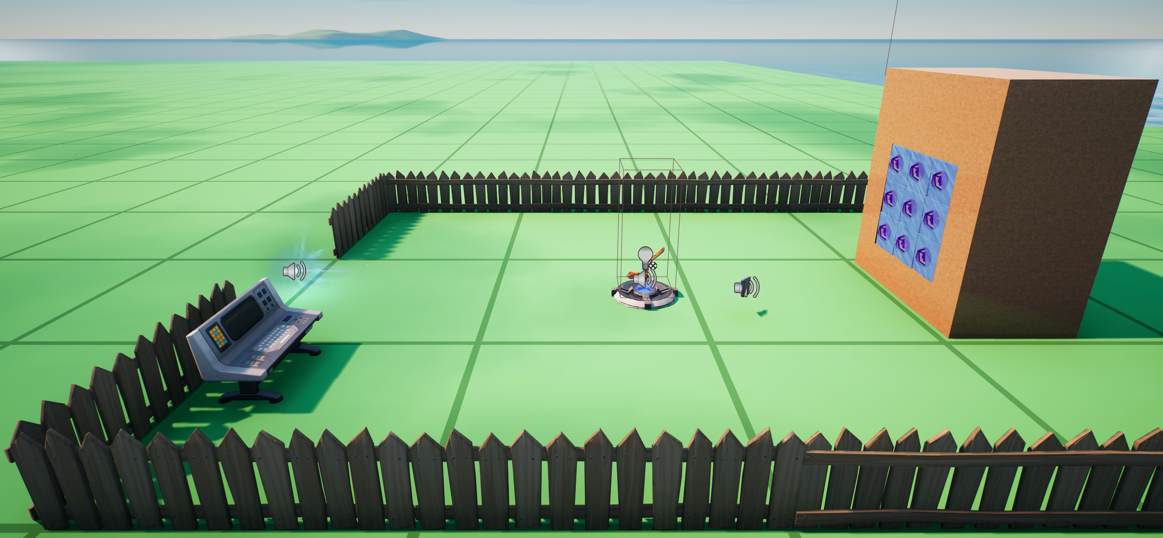
BillboardDevice
CubeProps[0]
CubeProps[2]
CubeManipulators[0]
CubeProps[8]
CubeManipulators[2]
CubeProps[6]
CubeManipulators[8]
CubeManipulators[6]
ResetButton

